Slide 1

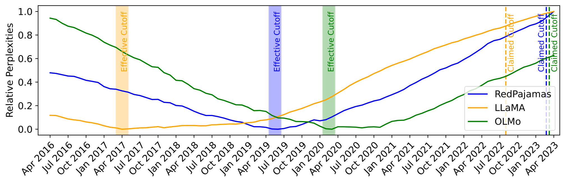
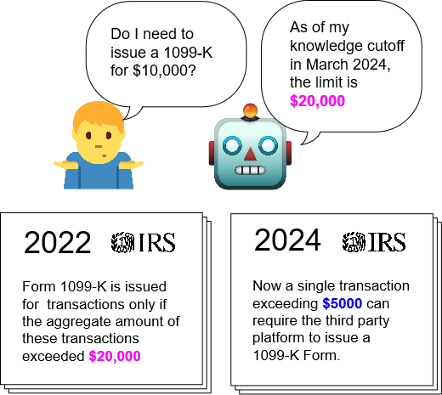
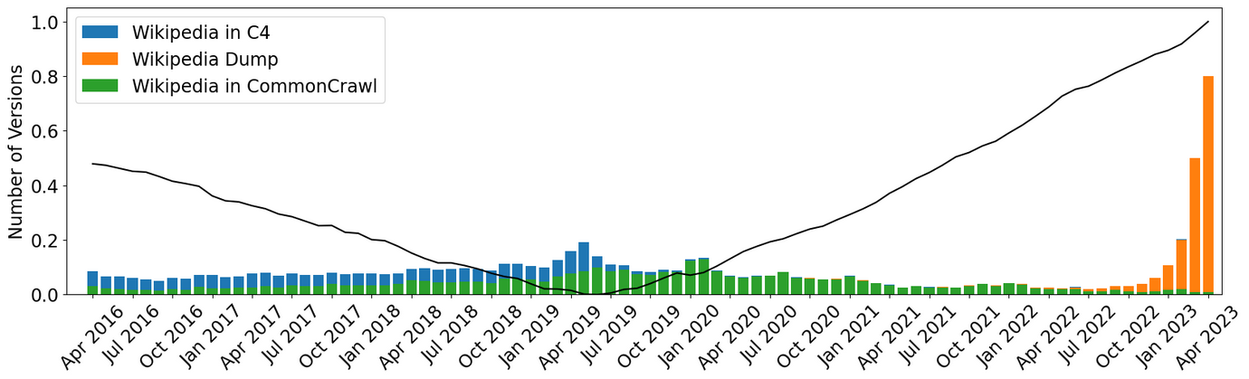
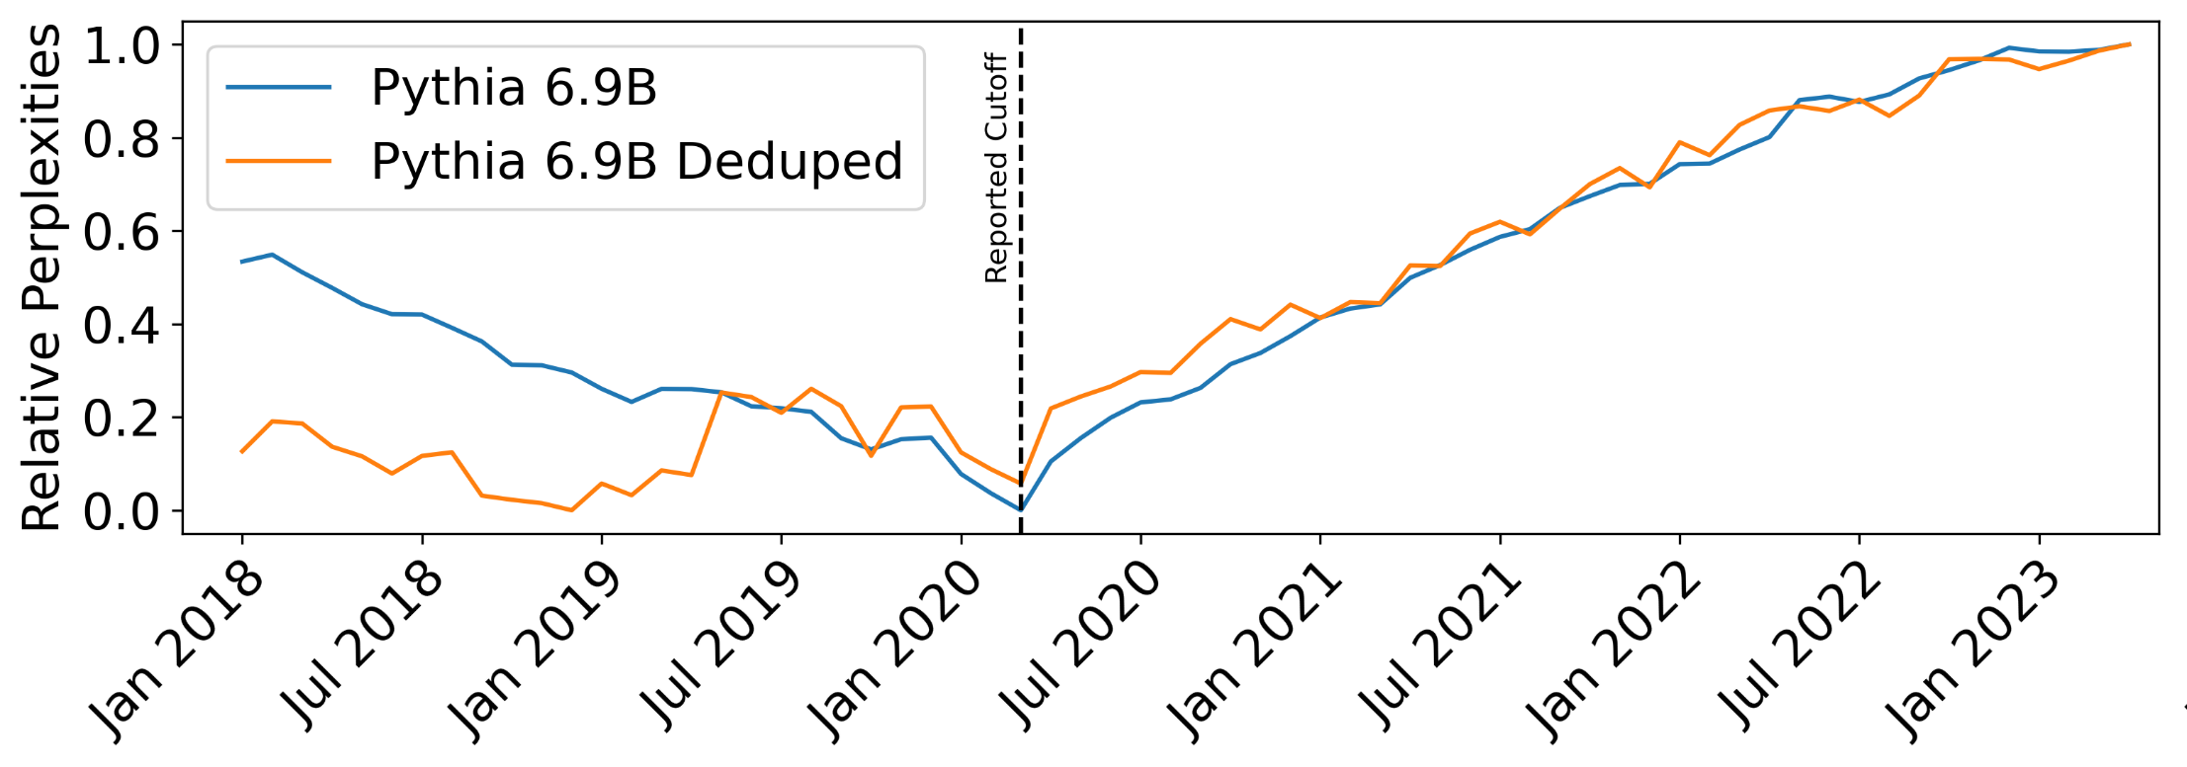
Dated Data: Tracing Knowledge Cutoffs
in Large Language Models
Jeffrey Cheng, Marc Marone,
Orion Weller, Dawn Lawrie,
Daniel Khashabi, Benjamin Van Durme
Introduction
Claimed and Effective Cutoffs
LLM creators often do not elect to release training data, instead providing a reported cutoff date.
Is this knowledge cutoff the same for each of its included resources (e.g. Wikipedia, ArXiv, Github)?
Does this knowledge cutoff match the model’s knowledge of the resource, or effective cutoff?
We propose a simple method to determine effective cutoffs without needing access to pre-training data, creating long spanning (2016-2023) datasets.
Our datasets consist of versions of Wikipedia and NYT documents, and we take the time at which perplexities are minimized to be the effective cutoff of that resource.
We measure effective cutoffs across a variety of language models and show that there exists drastic mismatches with reported cutoffs.
Can you trust reported knowledge cutoffs?
Duplication
CommonCrawl Misalignments
Despite it being common practice to deduplicate pre-training datasets, we empirically find many duplicates in most pre-training datasets.
We consider the Pythia suite, whose effective cutoffs match the reported cutoffs in part due to the purposeful upsampling of document versions at the reported cutoff date.
We confirm duplicate documents affect effective cutoffs by considering Pythia-deduped, which removes the upsampled documents.
Most modern LLMs are trained on CommonCrawl data, and our analysis reveals that a non-trivial amount of data inside each dump is old data.
We concretely show this for RedPajamas; the majority of its CommonCrawl dumps occur after 2020 yet most of its Wikipedia versions are from before 2020.
We identify two reasons that contribute to the temporal mismatch of a language model's reported and effective cutoff:
failures of deduplication pipelines to control for semantic duplicates and
the use of newer CommonCrawl dumps to provide updated information when they include significant amounts of older data

